Slide 1
Architects of THE JOY OF GIVING; RIGHT every WRONG, REX, KARMAVEER and Swachh Bharat Mission.

Slide 2
A very Warm Namaste to all my Friends and Fellow Fundraisers at NCPD 2019

Slide 3
Fundraising is not about MONEY, HONEY!

Slide 4
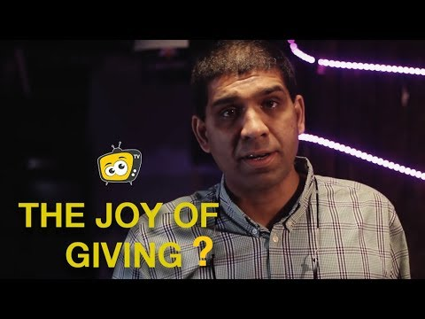

Slide 5
Fundraising is about creating JOY- THE JOY OF GIVING

Slide 6
The JOY OF GIVING
is not about making a donation,
but about
making a contribution
and
championing change to make a difference.

Slide 7
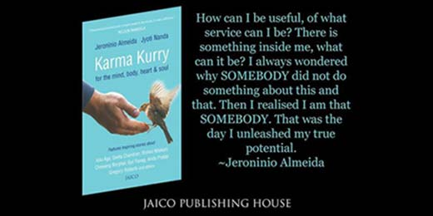

Slide 10
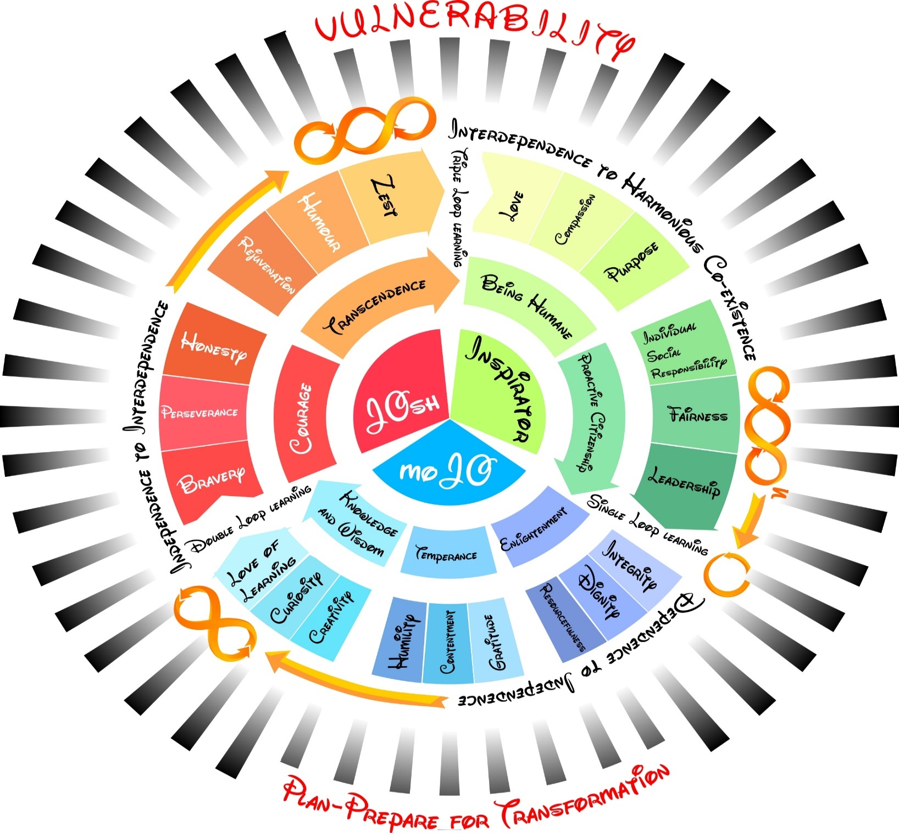

Slide 11
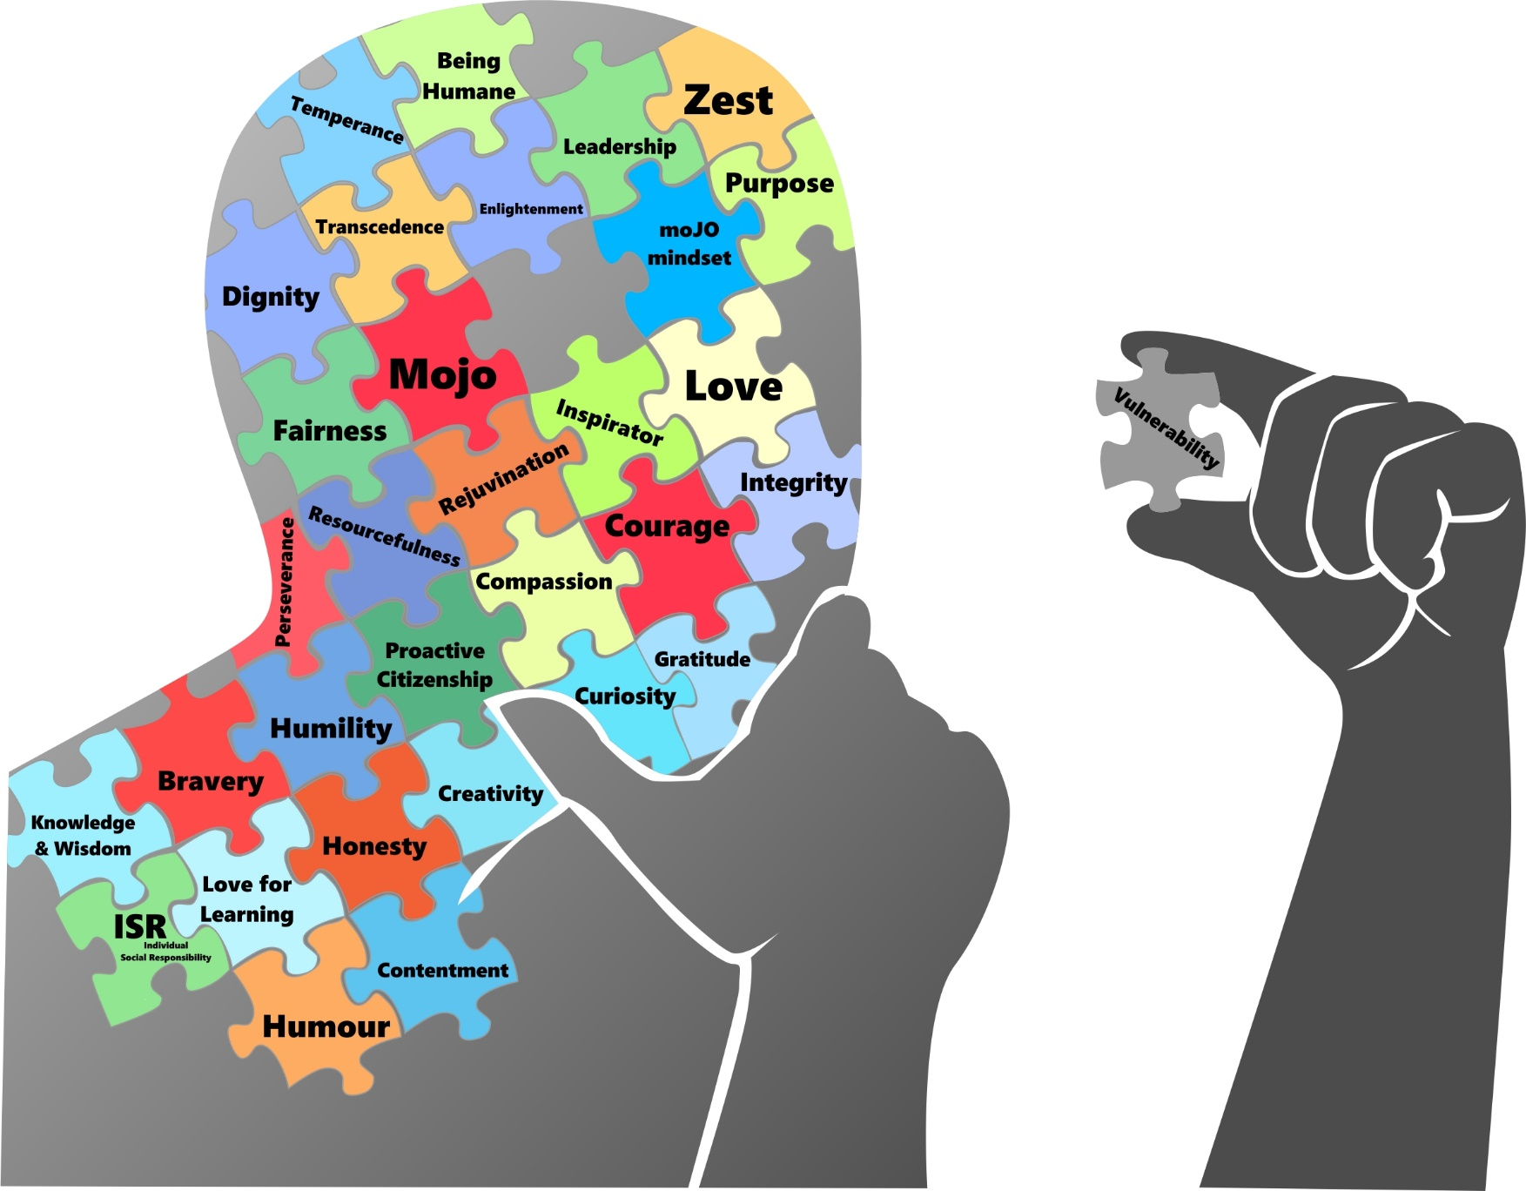

Slide 12
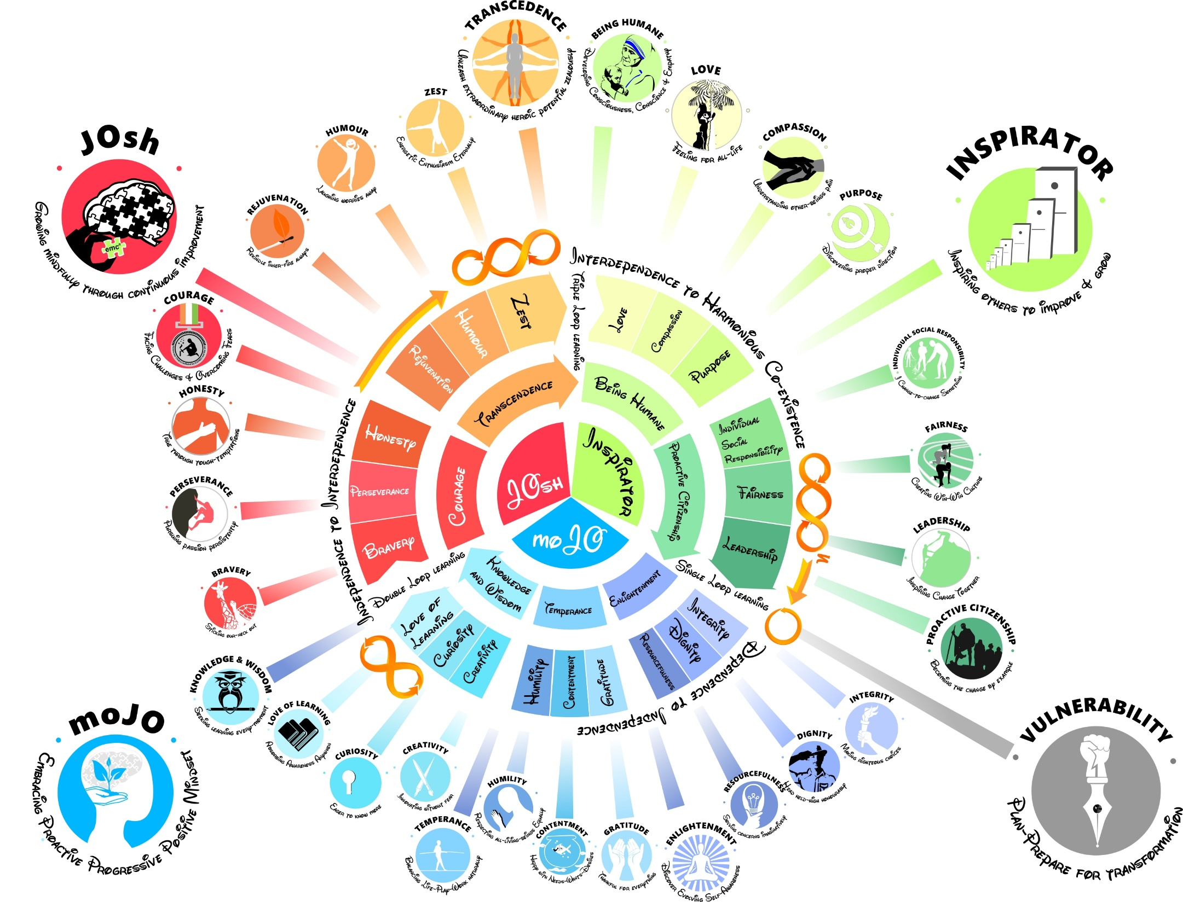

Slide 14
The 7 Fulfillments of Fundraisers
Enlightenment- Inspire Solid Character and Trust!
Temperance – Help People Balance their Give and Take
Knowledge & Wisdom- Clarify Purpose and cause dear to one’s heart.
Courage- Enable People to RIGHT WRONGS and take a stand
Transcendence – Empower People to GO FOR EXTRAORDINARY and LEAVE A LEGACY.
Being Humane – Fulfill the Responsibility as a Human Being, of creating a better, safer world.
Proactive Citizenship- Fight Apathy, Foster Empathy and Create More responsibility in people by unleashing their potential.

Slide 16
The GREATEST PERIL, I feel and foresee For The FUTURE OF HUMANITY is not War, Hunger, Poverty, Terrorism, Corruption, Religion or Conflict, but HUMAN APATHY.

Slide 17
F- Feel the JOY OF GIVING
U- Unleash Potential
N- No to Apathy
D- Do RIGHT
R- Rewarding Happiness and JOY
A- Ability to Respond
I- Inspiring Inspirators
S- Save The Planet and Humanity
I- Innovative Solutions
N- Nurture Empathy and Compassion
G- Generate Consciousness

Slide 19
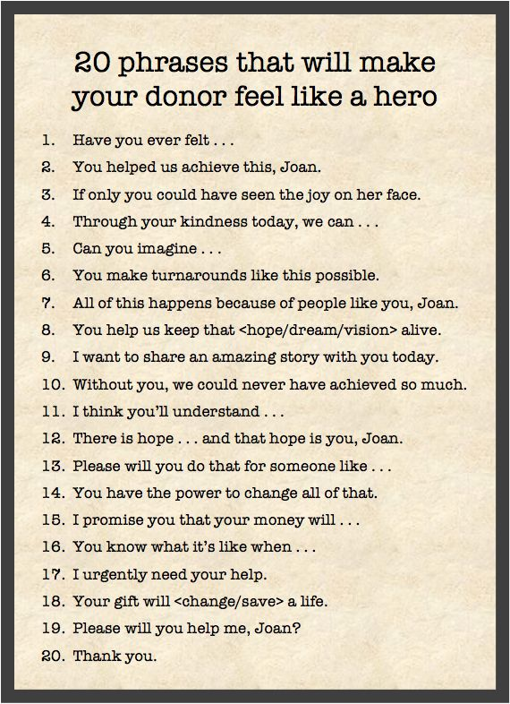

Slide 20
Help People to Feel Happy!

Slide 22
Help People to Feel Happ!

Slide 24
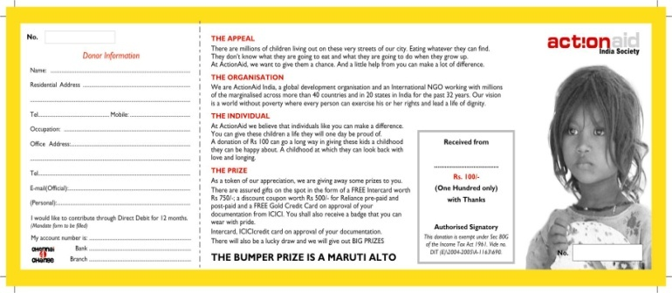
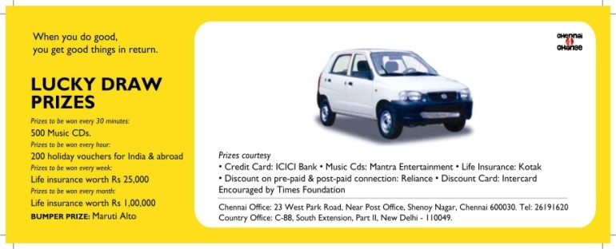
Background
Karma Mitra
Prince Charles was honored as a Karma Mitra-Friend in action by The Founders of iCONGO
Raffle Ticket

Slide 25
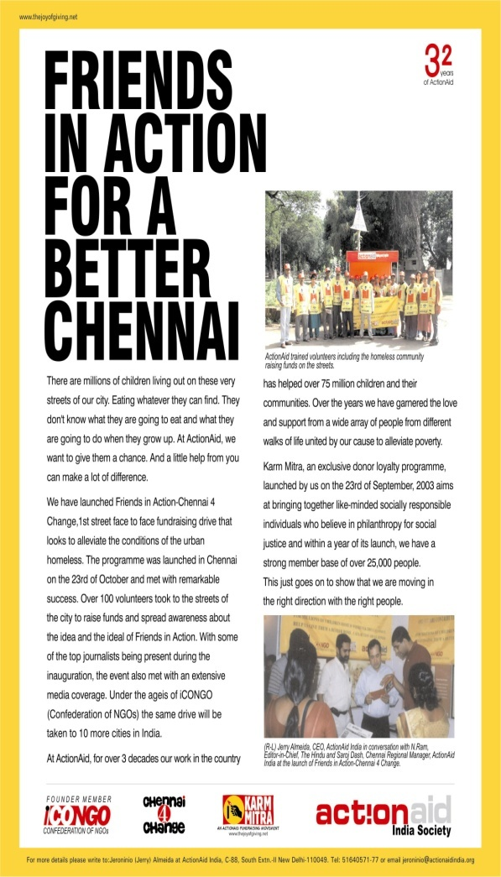

Slide 26
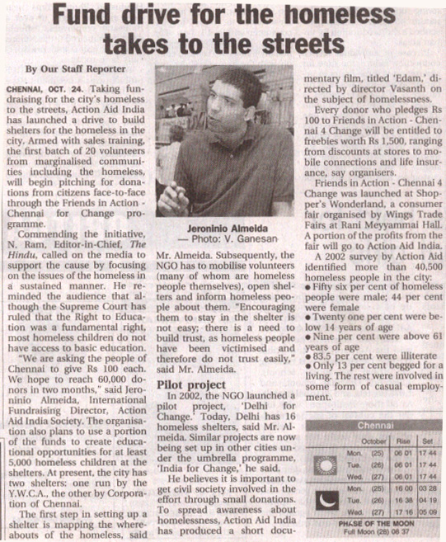

Slide 27
Background
Karma Mitra
Poster
Bookmarks
Banner

Slide 28
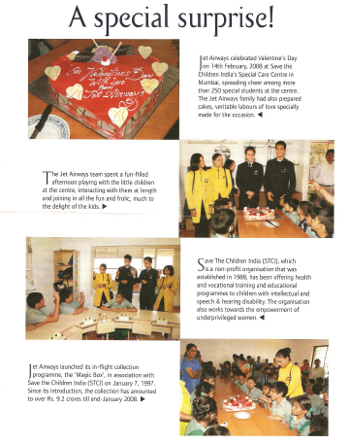
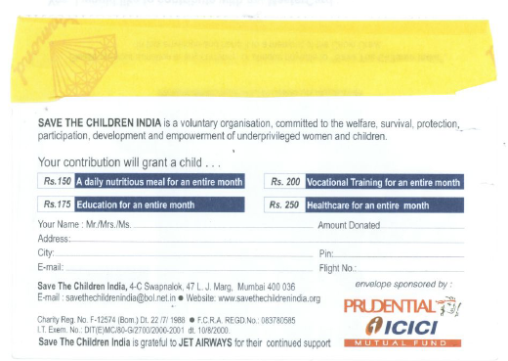
Background
Magic Box – Jet Airways
The founders of iCONGO created the Magic Box idea for Jet Airways & Save The Children , India. Passengers were given the coupon to select their donation amount and before the flight landed winners were chosen among the donors who collected their prize at Jet-Airways counter at the Airport. Through these donations it has helped victims of the earthquakes in Gujarat and Jammu & Kashmir, and those affected by the tsunami in 2004.

Slide 29
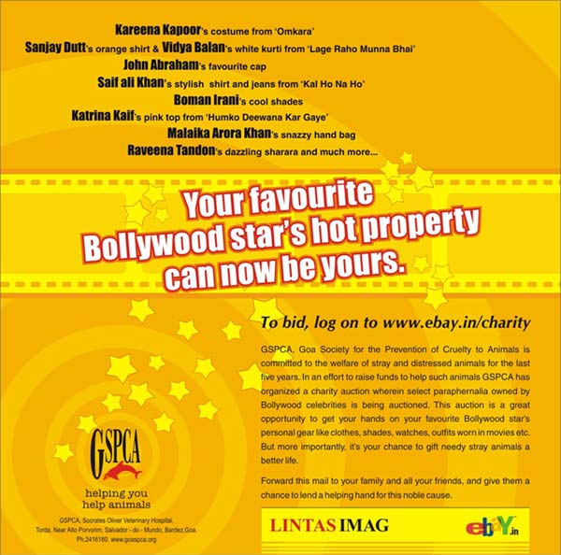
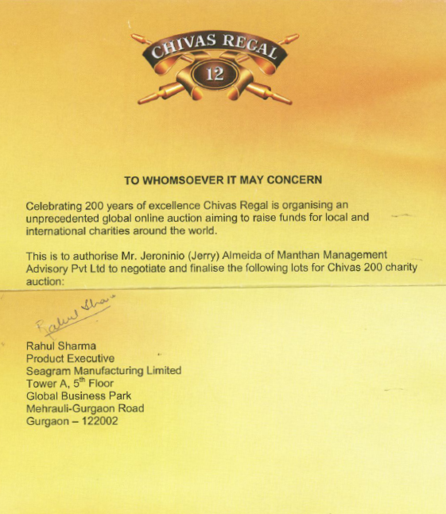
Background
Online Auctions and Events
The iCONGO Founders have conceptualised & organised high profile online auctions & events with global firms like eBay and Seagram's supporting the initiatives to raise Huge resources & create awareness.

Slide 30
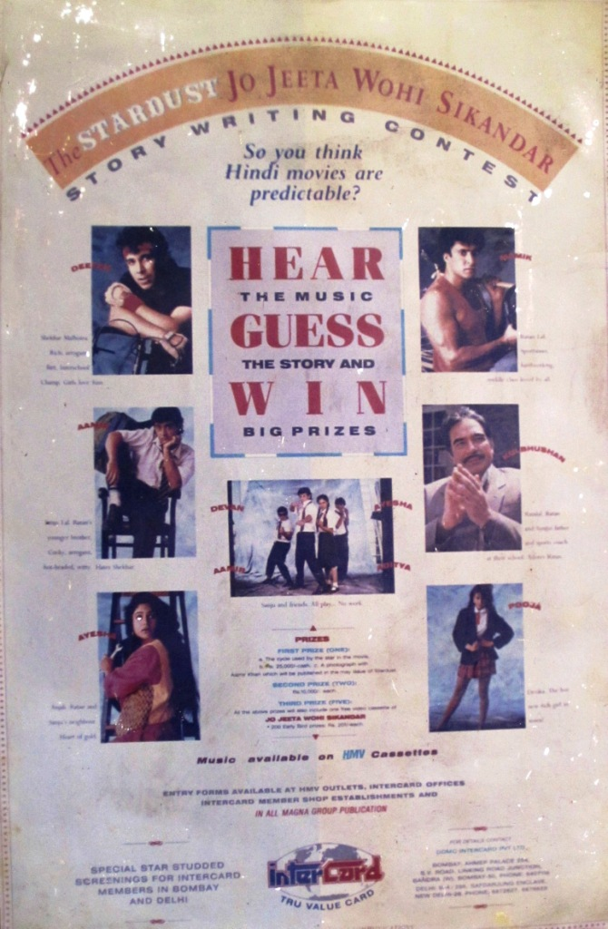
Background
Jo Jeeta Wohi Sikander – Contest
The founders of iCONGO designed the Story guessing contest for the promotion of the movie Jo Jeet Wohi Sikander in 1992, in partnership with Stardust, Intercard & HMV. Prizes like Cycles used in the movie, Picture with the Movies stars in the Stardust magazine, Special screening for the Intercard members and other prizes including cash prizes were given away.

Slide 33
Merchandise
iCan
RIGHTeveryWRONG
Sticker
T-shirt
iCan
RIGHT every WRONG
Wrist Band
Online Merchandise
Discount Coupons
Lapel Badge

Slide 34
Choose your Raffle numbers
Select the combination of numbers on your Raffle ticket.
You can choose your favourite 8 digit ticket no. out of 10 crore combinations. (Numbers can be selected through sum of your lucky no. e.g..
If your favourite no is 5 then choose (24796238 i.e. 2+4+7+9+6+2+3+8 = 41, 4+1 = 5)
Or choose these no. ending with 5 - 46572395, 47266355
Numbers ending in sequence, ----3456, -----786, ------555
These options will be visible to the customer while purchasing the ticket.
2. Submit it online with you personal detail which would be required to claim the winning prize.

Slide 35
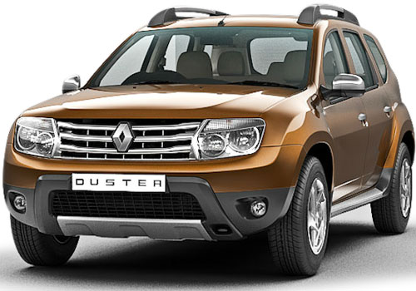
Raffle Ticket
KARMA RAFFLES
THE BUMPER PRIZE IS RENAULT DUSTER
84188538
KARMA RAFFLES

Slide 36
Ideas of Change
Karmaveer Chakra awarded instituted by iCONGO with UN.

Slide 37
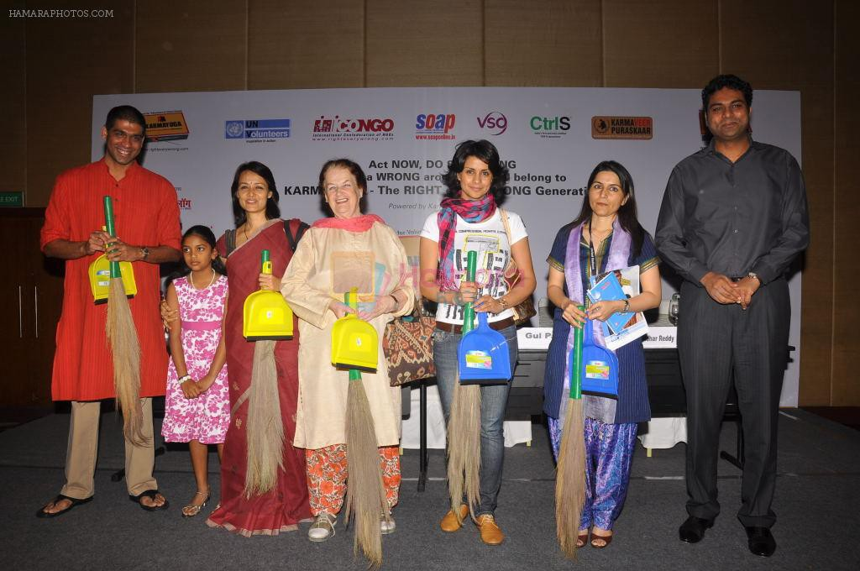

Slide 38
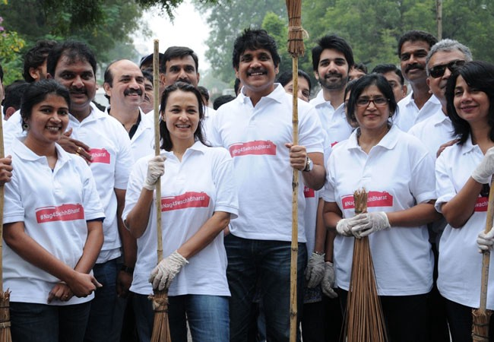

Slide 39
